Slide 1
Welcome to Antarctica

Slide 2
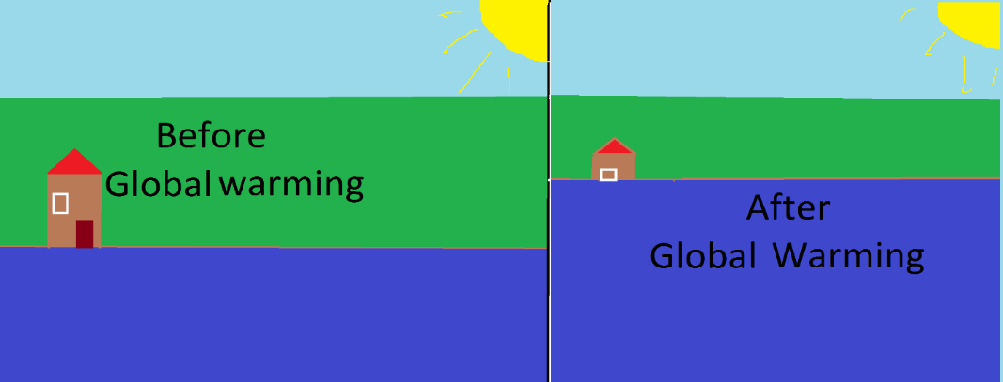
Environmental Issues : Global warming
Global warming affects us and Antarctica. Here’s how it works. Carbon dioxide (made from cars), makes a big invisible blanket above the earth, which traps heat. This heat will melt the ice poles (Antarctica) and raise the water level (as shown below). It can melt lots of Antarctica's ice and you may be submerged in water.

Slide 3
Antarctic Treaty
The Antarctic Treaty was signed in Washington on 1 December 1959 by twelve countries including Argentina, Australia, Belgium, Chile, France, Japan, New Zealand, Norway, South Africa, the Soviet Union, the United Kingdom and the United States.
The important parts of the treaty are
Antarctica shall be used for peaceful purposes only
Freedom of scientific investigation
Make Scientific observations and results freely available

Slide 4
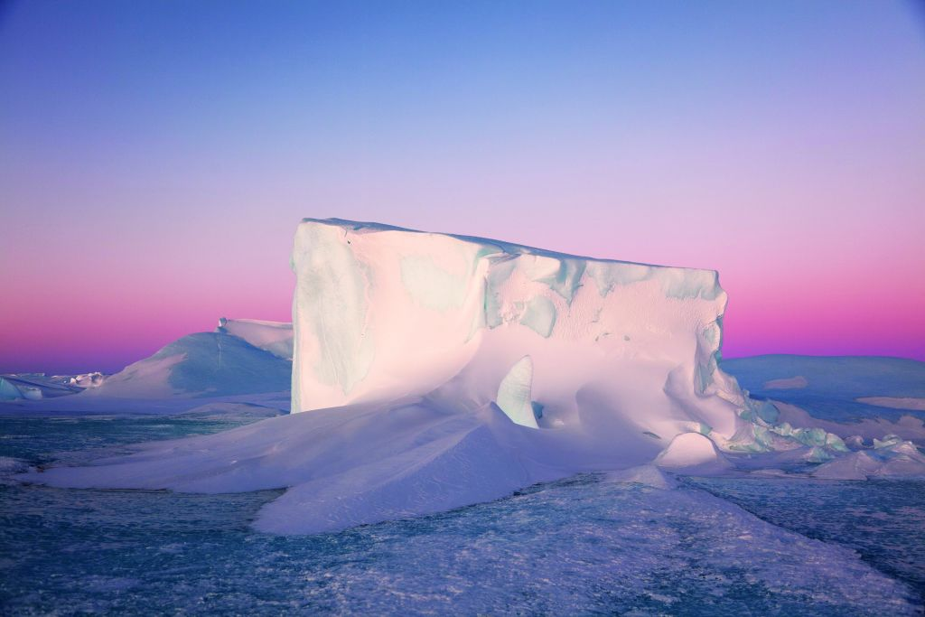
Antarctic Treaty
In 1991 the Protocol on Environmental Protection was added to the Antarctic treaty. This protocol is about protecting the environment and ecosystem in Antarctica. Mining is prohibited in Antarctica except for scientific research.

Slide 5
GUIDELINES

Slide 6
Transportation
You can get to Antarctica by cruise ship or a small sailing vessel or small motor vessel.
Do not use aircraft, hovercraft, small boats and vessels in a way which will disturb any wildlife
Boats must always check their routes and slow down so you will not hurt and disturb any wildlife
If you are refilling an engine, do it in a way which will not spill any fuel
If your ship has more then 500 people you may not land in Antarctica
Do not fly stuff over birds or seals

Slide 7
Disposal of food and human waste
Ensure that wastes are managed in accordance with Annexes III and IV of the protocol on Environmental Protection
Food and human waste shall not be disposed onto sea ice, ice shelves or ice sheet.
Sewage can be disposed into the sea if treated
Food wastes may be disposed into the sea faraway from land and ice shelves when they have been passed through a grinder

Slide 8
Conservation of Flora and Fauna (plants and animals)
Do not disturb any animals
If wildlife changes its behaviour stop moving
Stay 5 (or more) metres away from wildlife
Do not damage any plants (including moss)
Do not bring any plants and animals into Antarctica

Slide 9
What can I do in Antarctica?
There are lots of things you can do in Antarctica such as:
Whale watching
Skiing
Kayaking
Helicopter rides

Slide 10
Thank you for watching this presentation

